Slide 1


Project Aerivia
An in-depth analysis for the development of Project Aerivia
CODEVILLE
research

Slide 2
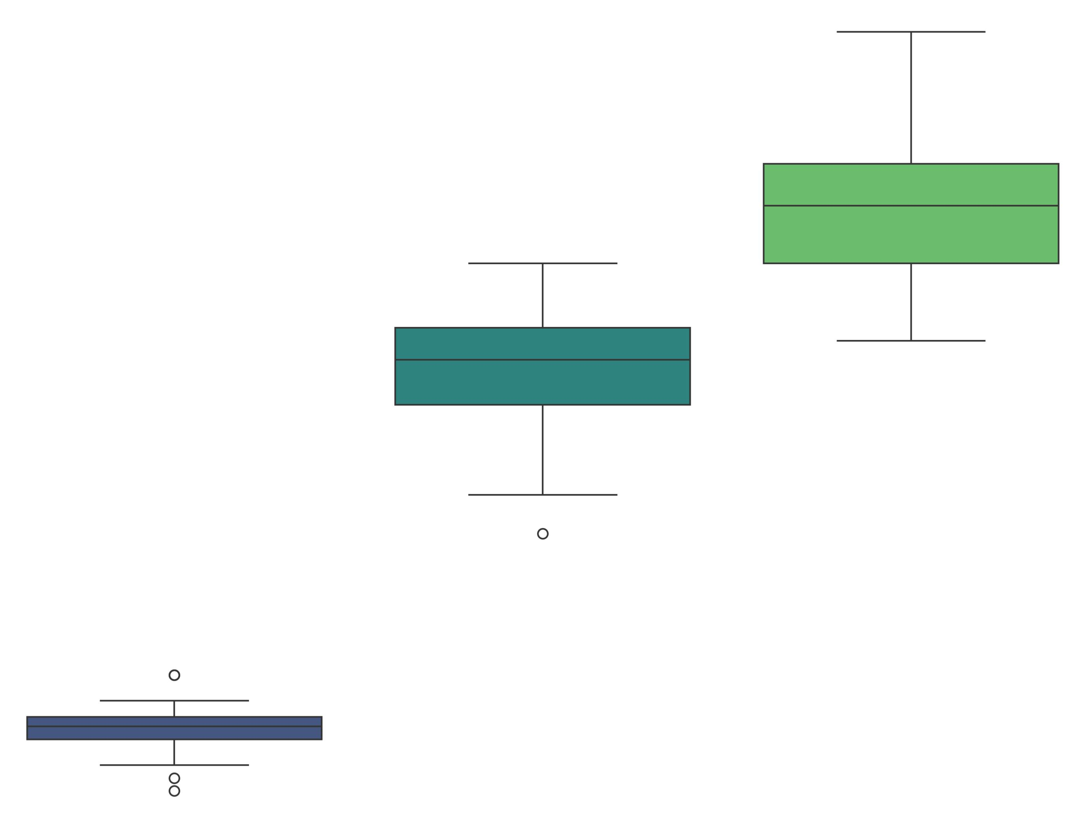
About
A presentation of insights aimed at informing the development of the Aerivia app in order to distinguish it from similar apps in it’s category.
We aim to:
Understand key factors influencing travel choices and booking habits within the provided dataset.
Specifically, we aim to provide actionable insights and visualizations to guide the development of an intuitive and personalized airline application.
CODEVILLE
research

Slide 3
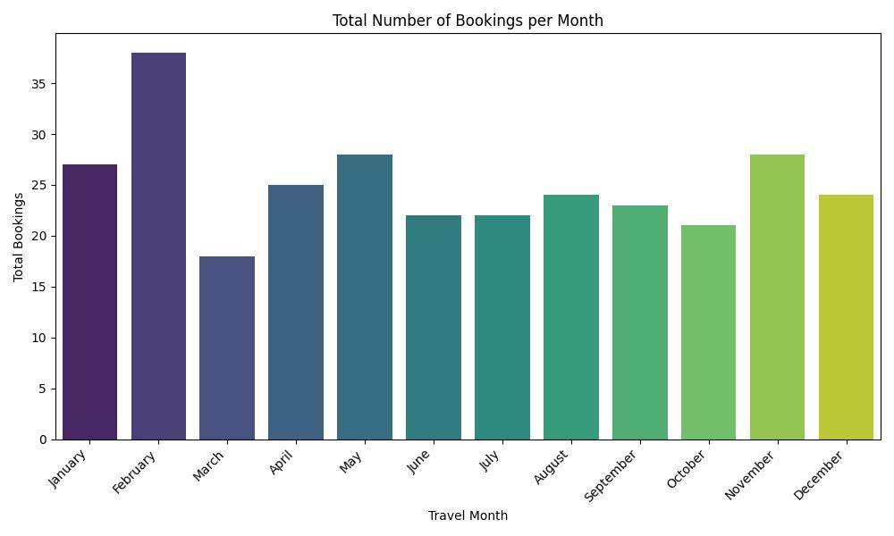
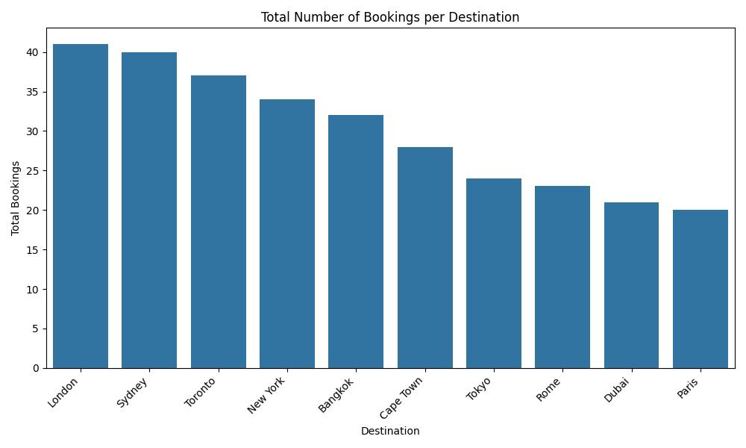
Section One
Starting with visual representations of the given dataset.
ANALYSIS
CODEVILLE
research

Slide 4
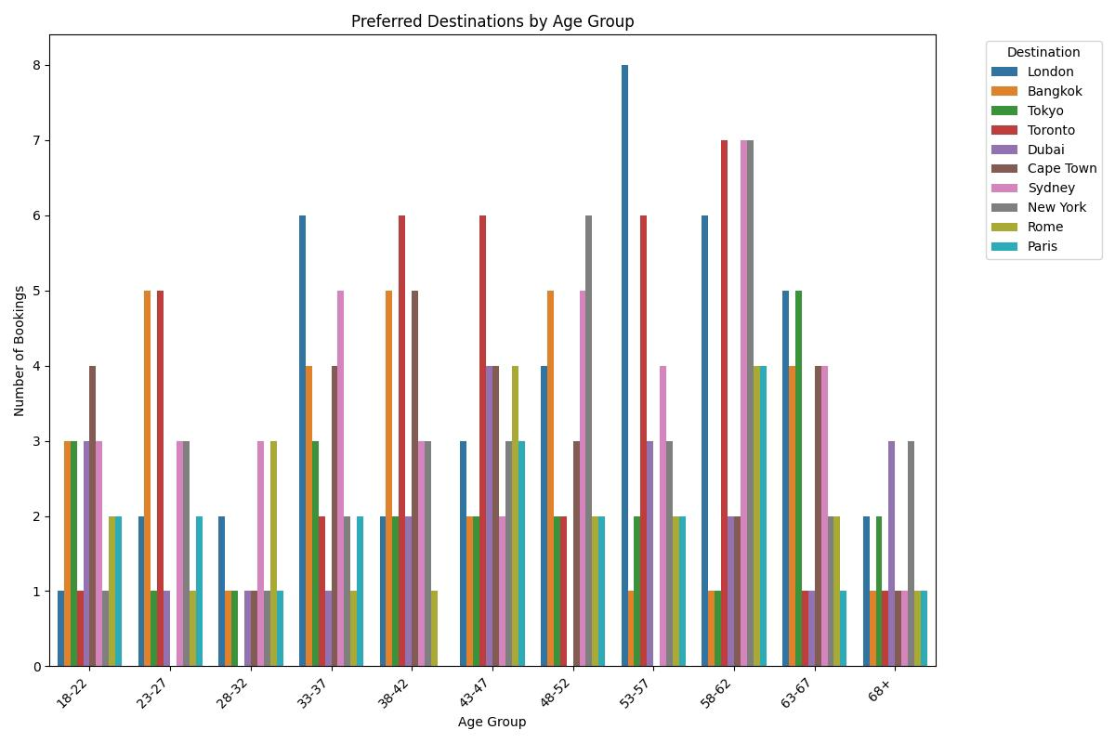
Insights
Bookings by Age Group Distribution.
Age Group Distribution: The count plot of travels by age group and the histogram of customer age distribution show the age range of the customers and which age groups travel the most. The 58-62 age group appears to have the highest number of travels.
Age Group Preferences: The grouped bar chart of preferred destinations by age group reveals that different age groups have varying preferences for destinations. This insight can be valuable for targeted marketing.
CODEVILLE
research

Slide 5
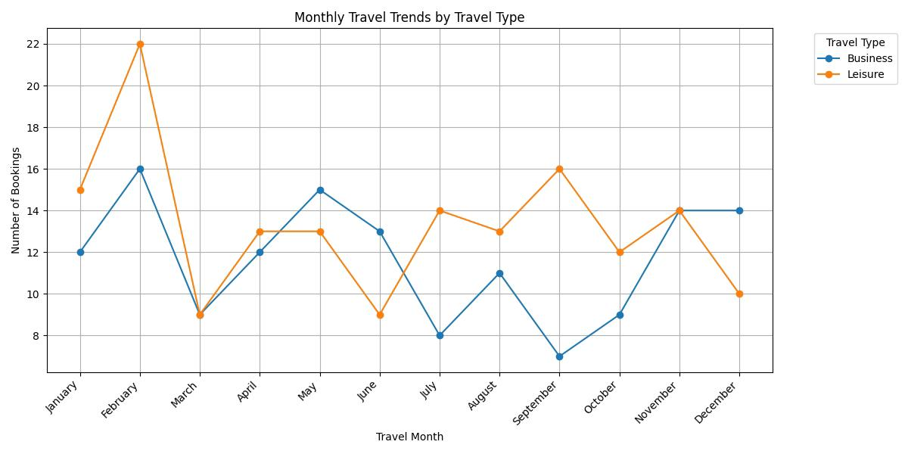
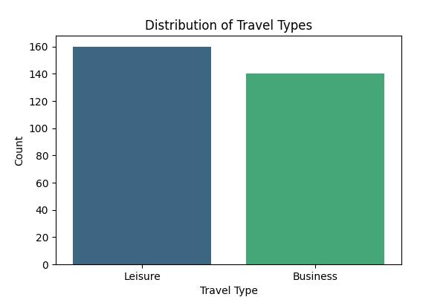
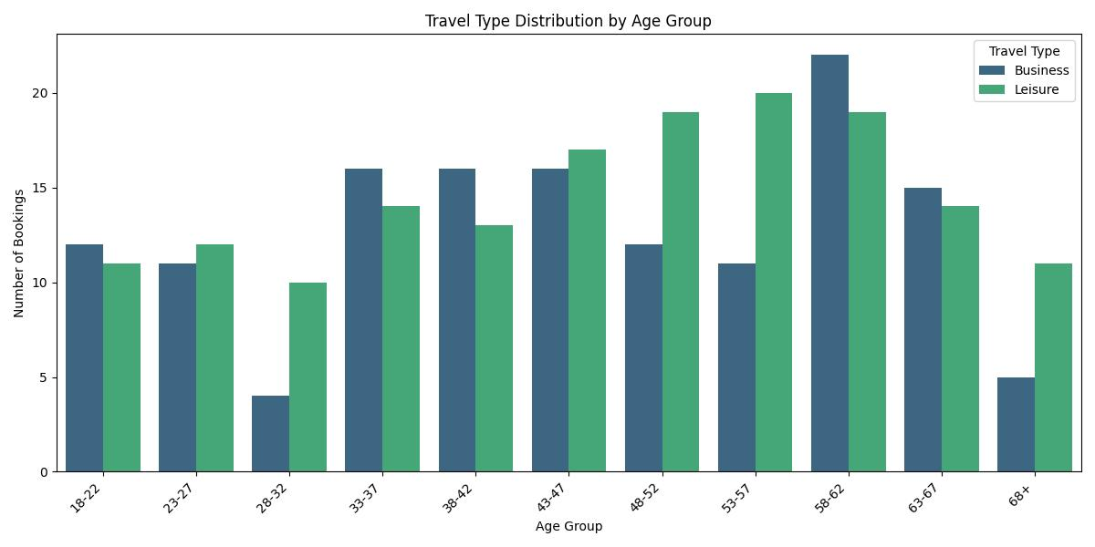
Insights
This shows that Customers travel more for Leisure than Business.
Overall Trends: Both business and leisure travel show variations throughout the year.
Peak Months: February appears to be a peak month for leisure travel, while business travel seems to have a few peaks throughout the year, including February and November.
Low Months: March seems to be a low month for both business and leisure travel.
Relative Popularity: Throughout most of the year, leisure travel appears to have a slightly higher number of bookings compared to business travel, although there are months where business bookings are comparable or slightly higher.
Monthly Travel Trends by Travel Type
CODEVILLE
research

Slide 6
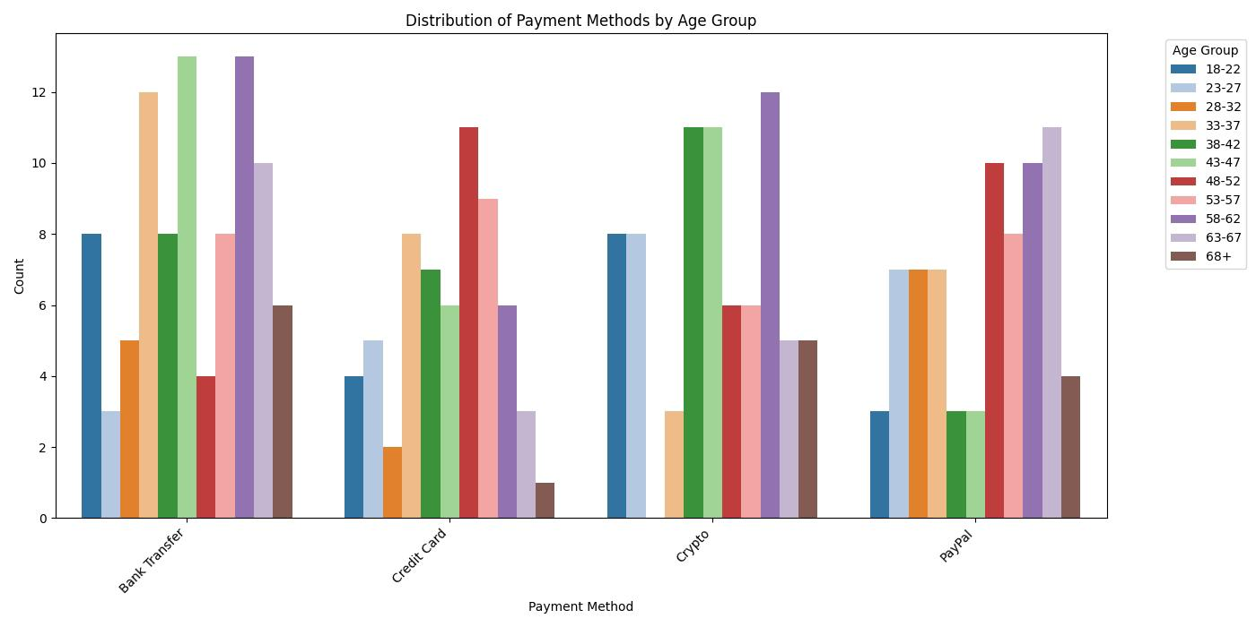
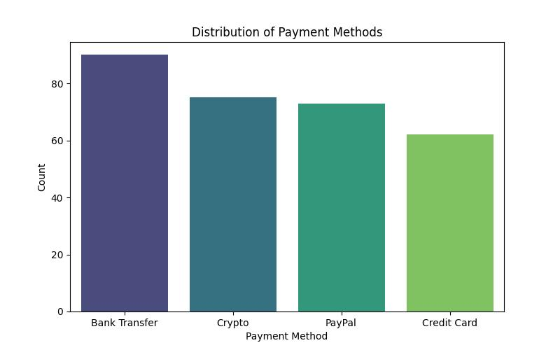
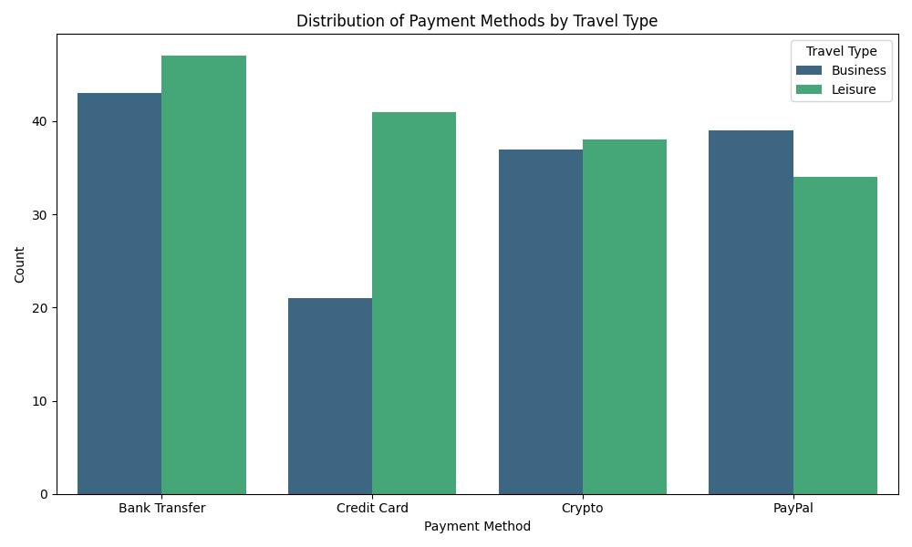
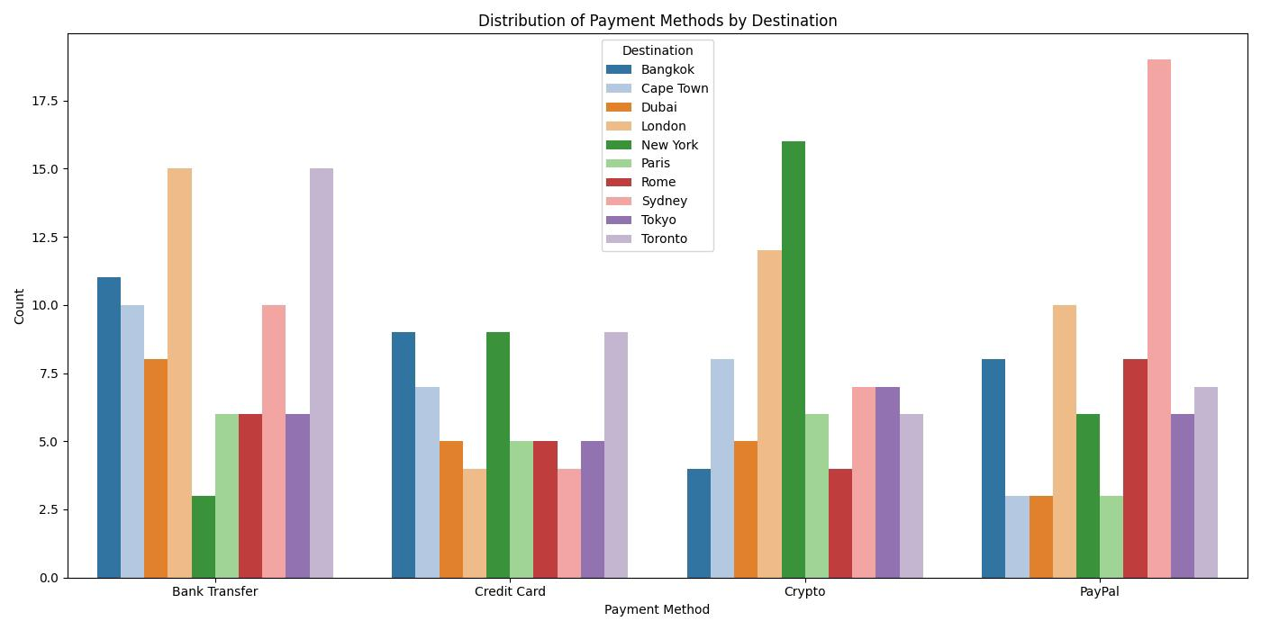
Insights
Bank Transfer, Paypal, and Crypto are more popular for business travel, while Credit Card and PayPal are more popular for leisure travel. Although Bank Transfer also shows high usage in leisure travel as well.
Bookings by Payment Method
Payment Method Distribution: The bar plot of the distribution of payment methods indicates the most frequently used payment methods. Bank Transfer, Crypto, and PayPal are the most common payment methods.
Payment Method by Travel Type, Destination, and Age Group: The grouped bar charts exploring payment methods by travel type, destination, and age group provide insights into whether certain payment methods are preferred for specific travel types, destinations, or by particular age groups. For example, Bank Transfer and Paypal are more popular for business travel, while Credit Card and PayPal are more popular for leisure travel.
CODEVILLE
research

Slide 7
Section Two
SUMMARY
A Summary of Insights and key take away.
CODEVILLE
research

Slide 8
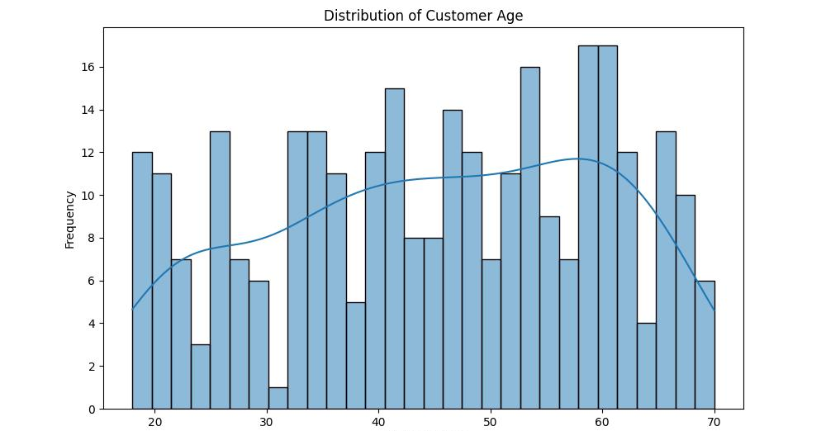
title
SUMMARY
Based on the analysis of the travel dataset, here’s a summary of key findings that can inform the design and development of the app:
Summary of Analysis for App Development.
Target Audience: The data suggests a diverse age range of travelers, with the 58-62 age group showing the highest travel frequency. The app should cater to different age segments with appropriate features and user interfaces.
CODEVILLE
research

Slide 9
title
SUMMARY
Summary of Analysis for App Development.
Popular Destinations and Seasons: London, Sydney, and Toronto are the most popular destinations, with February being the peak travel month and March the lowest. The app can highlight popular destinations, offer seasonal promotions, and provide insights into peak travel times.
Travel Type Preferences: Both leisure and business travel are significant, with leisure being slightly more common. The app should support features relevant to both travel types, such as business travel profiles, expense reporting, and leisure activity recommendations.
CODEVILLE
research

Slide 10
title
SUMMARY
Summary of Analysis for App Development.
Relationship between Factors: The analysis of payment methods by travel type, destination, and age group reveals interesting correlations. For instance, certain payment methods are more popular for business travel or specific destinations. This can inform payment options presented to users based on their travel details.
Age-Specific Preferences: Different age groups show varying preferences for destinations and potentially travel types. The app can leverage this by offering personalized recommendations and targeted deals based on user age and past travel behavior.
Payment Method Trends: Bank Transfer, Crypto, and PayPal are the most frequently used payment methods. The app should prioritize seamless integration with these payment options and potentially explore other popular methods based on the target market.
CODEVILLE
research

Slide 11
title
Integrating Insights for App Development
CONCLUSION
This analysis provides key insights to enhance the airline app, focusing on user behavior, marketing effectiveness, product performance, and business health.
User Behavior: Understanding age groups, destinations, and travel types allows for personalized experiences and features tailored to user preferences.
Marketing Effectiveness: Insights into popular destinations, peak seasons, and age/travel type preferences enable targeted promotions and timely messaging.
Product Performance: Analyzing travel types and payment methods helps optimize booking flows and integrate preferred payment options for a smoother user experience.
Business Health: By improving user engagement, marketing efficiency, and operational performance, the app contributes to increased bookings, revenue, and overall business growth.
CODEVILLE
research

Slide 12
title
Integrating Insights for App Development
CONCLUSION
Integrating these findings is essential for creating a user-centric, effective, and successful airline application.
CODEVILLE
research

Slide 13




Thank You
Data Analytics Team
+234 806 015 6385
+23470 8039 3332
+234 812 659 6588
+234 808 392 6967
+234 905 468 3321
Codeville Research
https://drive.google.com/drive/folders/1pjL5TjitU1kiAk3TuDryWRJmEm4mCWdk?usp=sharing
CODEVILLE
research

